Slide 1



SVM

Slide 2
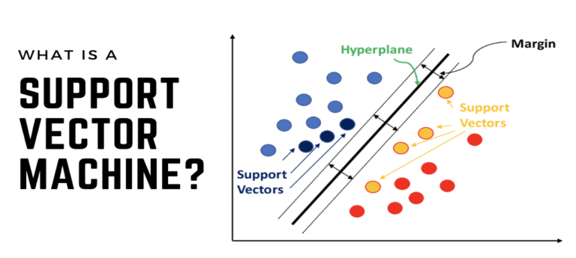

Slide 3
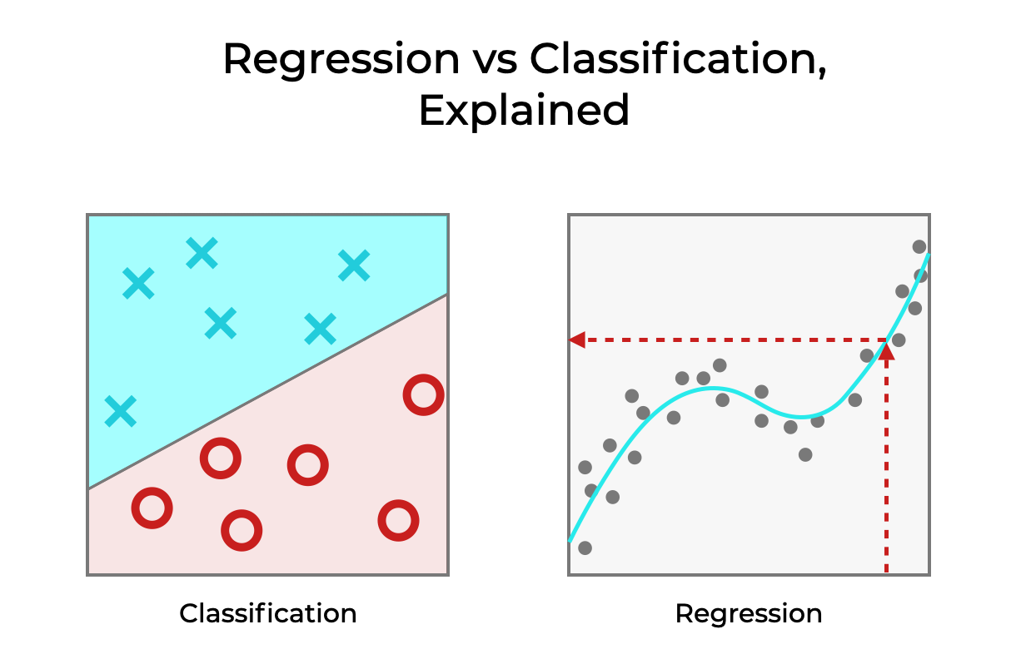
Used for Regression as well as Classification

Slide 4
02
How Does SVM WORK?

Slide 5
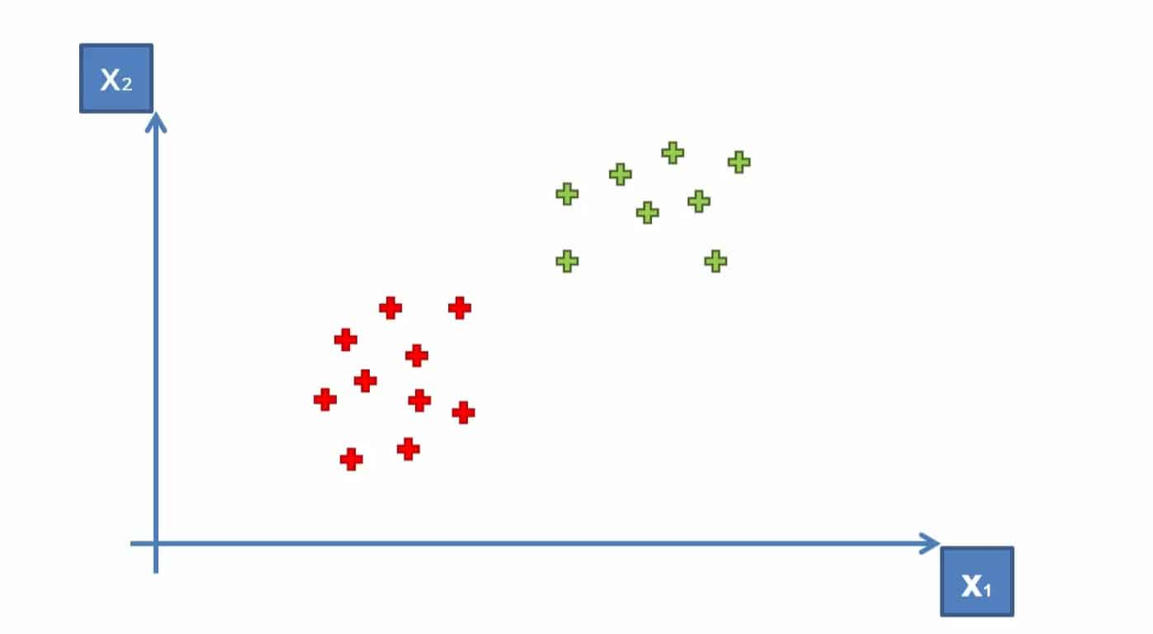

Slide 6
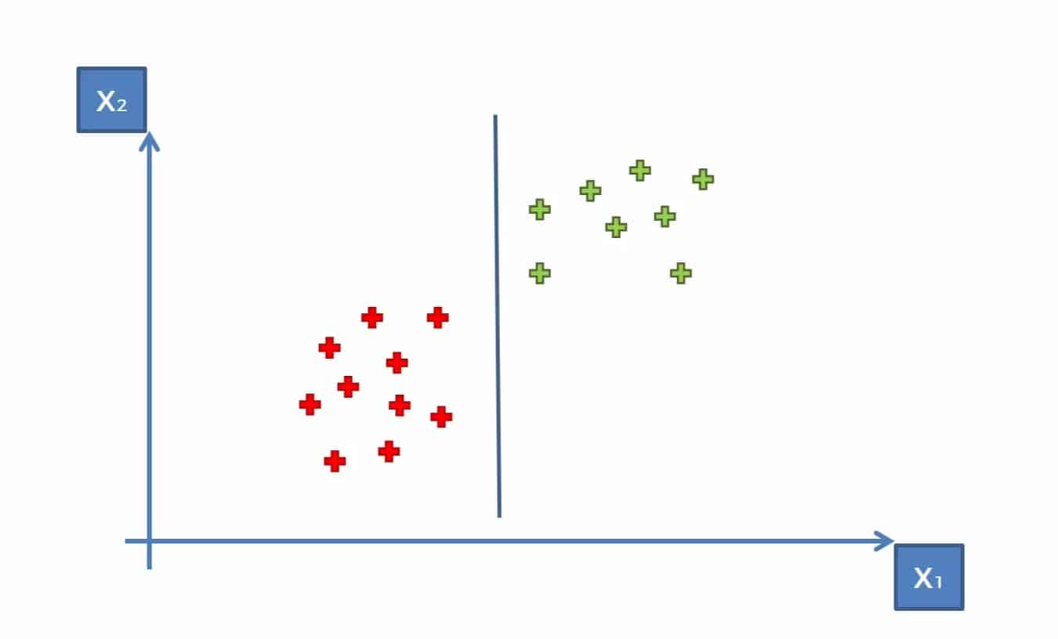

Slide 7
GOAL
Find optimal line or best decision boundary

Slide 8
